Slide 1




Financial Management
Assignment
Group 33

Slide 2
Group Members
Rishabh Nanda 2022A3PS0652H
Vaishnu Kanna 2022B3A71608H
Aarav Haran 2022B3A0880H
Aditya Pentyala 2022B3A70522H

Slide 3
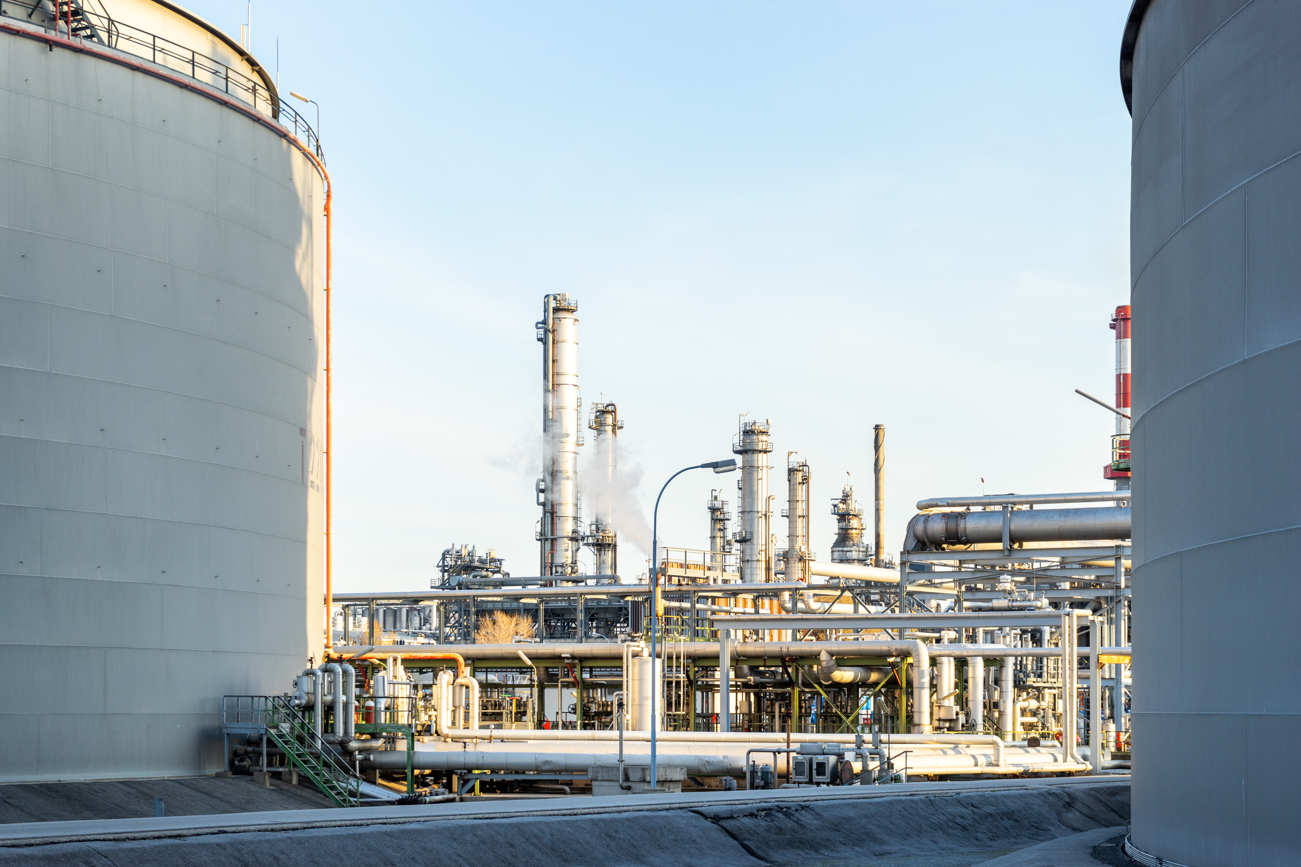
Market Capitalisation
The market capitalization, commonly called market cap, is the total market value of a publicly traded company's outstanding shares and is commonly used to measure how much a company is worth.
As of April 2024 Hindustan Petroleum has a market cap of 651.75 billion INR

Slide 4
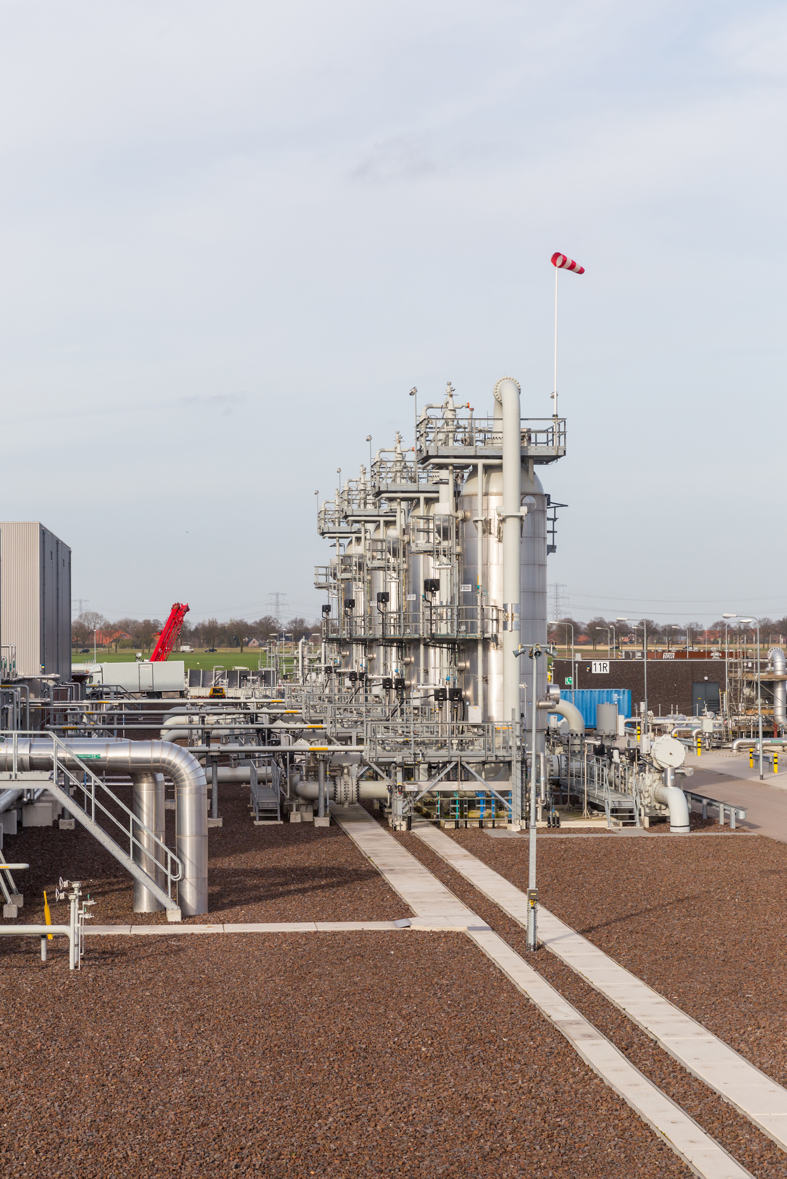
Industry
Hindustan Petroleum Corporation Ltd. is a Government of India Enterprise with a Maharatna Status(PSU) and a Forbes Global 500 company
It is a subsidiary of the Oil and Natural Gas Solution (ONGC)
HPCL deals in the Oil and Gas Industry with its operations spread across sectors like Crude Oil Refining, Petrol Pumps, Aviation Fuel, Natural Gas, Petrochemicals, Renewables etc.
It operates two major refineries in Mumbai and Visakhapatnam with installed refining capacity of 7.5 MMTPA and 8.3 MMPTA

Slide 5
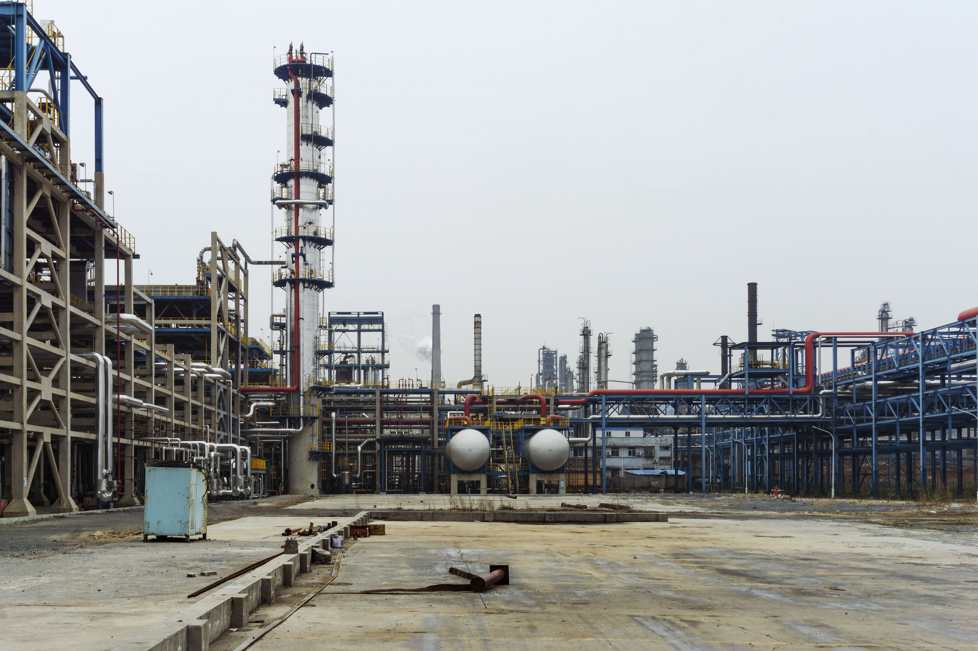
Services and Products
Products of HPCL include
Fuels ( Automobile and Aviation)
Petrochemicals
Lubricants
LPG and CNG
Renewable Energy
Cooking Gas
Pipeline Projects
Research and Development

Slide 6
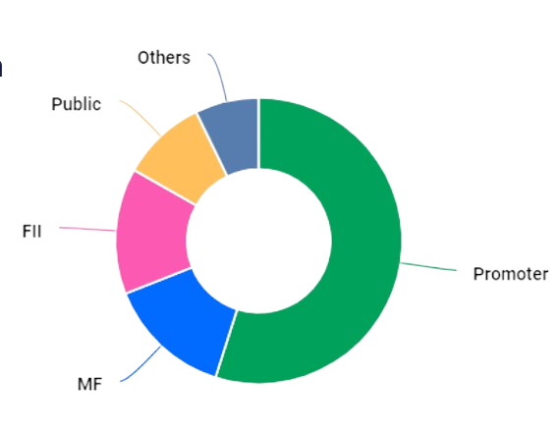
Shareholding Pattern
Changes in shareholdings for the last quarter Dec 2023 :
Promoters holding remains unchanged at 54.90%
FII/FPI have increased holdings from 13.26% to 14.26%
Mutual Funds have decreased holdings from 14.29% to 14.10%

Slide 7
Board of Directors
Mr. Pushp Kumar Joshi | Chairman & Managing Director
Mr. Rajneesh Narang | Director - Finance
Mr. S. Bharathan | Director - Refineries
Mr. Amit Garg | Director - Marketing
Mr. K S Shetty | Director - Human Resources
Ms. Sujata Sharma | Government Director
Mr. Pankaj Kumar | Government Director
Mrs. Vimla Pradhan | Independent Director
Mr. Bechan Lal | Independent Director
Mr. Vivekananda Biswal | Independent Director
Mr. Ramdarshan Singh Pal | Independent Director
Dr. Nagaraja Bhalki | Independent Director
Mr. K S Narendiran | Independent Director

Slide 8
Competitive Companies
Indian Oil Corporation ltd.
Bharat Petroleum Corporation ltd.
Chennai Petroleum Corporation ltd.
Mangalore Petroleum Corporation ltd.

Slide 9
Calculating cost of equity capital - Top - Down Approach (notebooks for each company available at this github directory/repo )
Company | Beta - coefficient | Intercept
BPCL | 1.2529 (0.167) | -0.0022 (0.009)
IOCL | 1.0324 (0.163) | 0.0021 (0.009)
CPCL | 1.3004 (0.389) | 0.0118 (0.022)
MRPL | 1.3580 (0.342) | 0.0082 (0.019)
HPCL | 0.9683 (0.196) | -0.0005 (0.011)

Slide 10
Calculating Cost of Equity Capital - Bottom-up Approach - Financial Data used:
Sources: Finology , Yahoo finance
Company | D/E Ratio
HPCL | 2.33
BPCL | 1.14
MRPL | 1.69
IOCL | 1
CPCL | 0.66
Corporate Tax rate | 25% | source
Risk Free Rate | 7.1361% | source
Stock Price | ₹458.85 | source
No. of Shares | 141.85 cr | source
Market risk premium | 1.43% | source

Slide 11

WACC Calculation
A firm's Weighted Average Cost of Capital (WACC) represents its average cost of capital incorporating various sources of financing, including common shares, preferred shares, and debt.
Here,
Cost of equity Re = 0.1035
Cost of debt Rd = 0.14
Ws = E/V = 0.3
Wb = D/V = 0.699
Tax = Tc = 0.3
Thus, WACC = 0.09965

Slide 12
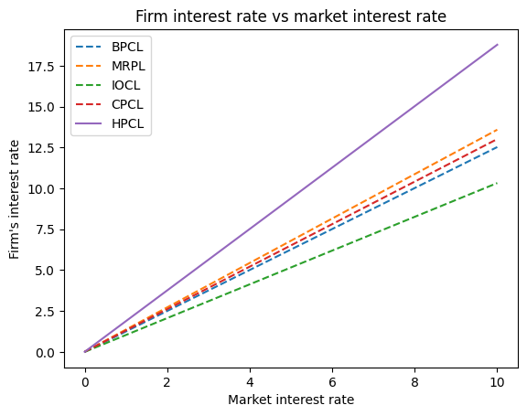
HPCL’s interest rate is higher than its market competitors due to its capital structure.

Slide 13
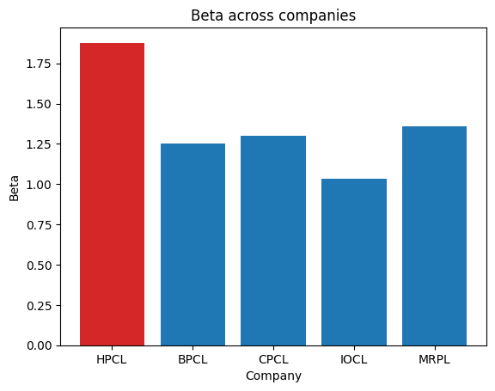
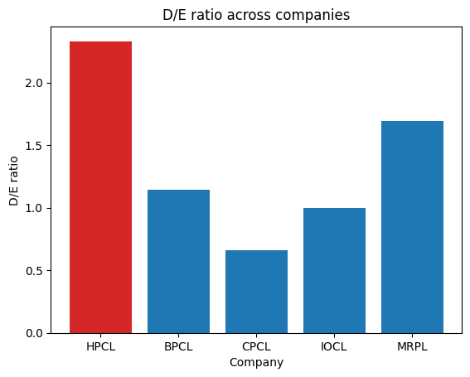
Beta and D/E ratio of HPCL is significantly higher than its peer companies in the market

Slide 14
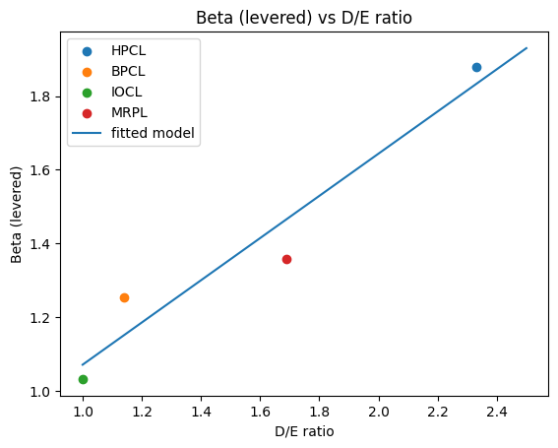
From the above Beta vs D/E graph, we can conclude that there seems to exist positive correlation between a higher D/E ratio and Beta for the firm.

Slide 15
Thank you

